Slide 1
CPS 235 Object Oriented Programming Paradigm
Lecturer Rabia Khan

Slide 2
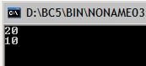
class CRectangle: public CPolygon
{
public:
int area ()
{ return (width * height); }
};
class CTriangle: public CPolygon
{
public:
int area () { return (width * height / 2); }
};
int main ()
{
CRectangle rect;
CTriangle trgl;
CPolygon * ppoly1 = &rect;
CPolygon * ppoly2 = &trgl;
ppoly1->set_values (4,5);
ppoly2->set_values (4,5);
cout << rect.area() << endl;
cout << trgl.area() << endl;
}
class CPolygon
{ protected:
int width, height;
public:
void set_values (int a, int b)
{ width=a; height=b; }
};

Slide 3
Why need Virtual Functions?
Why was area() called by rect and trgl objects and not through pointers *ppoly1, *ppoly2?
Both *ppoly1 and *ppoly2 are of type CPolygon*and therefore we can only use these pointers to refer to the members that CRectangle and CTriangle inherit from CPolygon. For that reason when we call the area() members at the end of the program we have had to use directly the objects rect and trgl instead of the pointers *ppoly1 and *ppoly2.
How to use area() with the pointers to class CPolygon?
Solution = Virtual Functions!!

Slide 4
Virtual Members
A member of a class that can be redefined in its derived classes is known as a virtual member. In order to declare a member of a class as virtual, we must precede its declaration with the keyword ”virtual”
So, if we want area() to be able to be called by pointers to CPolygon it has to be a part of CPolygon but still have the permission to redefine it in CRectangle and CTriangle then it HAS to be declared virtual!

Slide 5
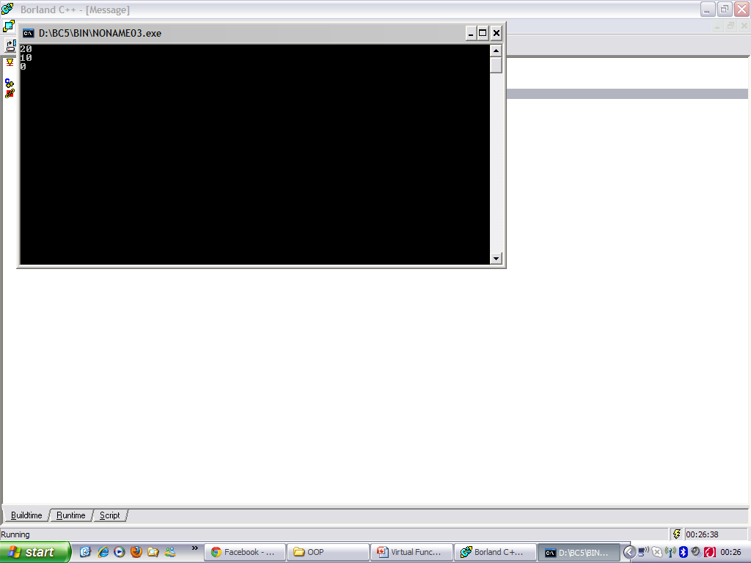
class CRectangle: public CPolygon
{
public:
int area ()
{ return (width * height); }
};
class CTriangle: public CPolygon
{
public:
int area () { return (width * height / 2); }
};
int main ()
{ CRectangle rect; CTriangle trgl; CPolygon poly;
CPolygon * ppoly1 = &rect;
CPolygon * ppoly2 = &trgl;
CPolygon * ppoly3 = &poly;
ppoly1->set_values (4,5);
ppoly2->set_values (4,5);
ppoly3->set_values (4,5);
cout << ppoly1->area() << endl;
cout << ppoly2->area() << endl;
cout << ppoly3->area() << endl;
}
class CPolygon
{ protected:
int width, height;
public:
virtual int area () { return (0); }
void set_values (int a, int b)
{ width=a; height=b; }
};

Slide 6
Virtual Members
What if the function in the CPolygon is not declared as virtual?
The member function area() has been declared as virtual in the base class because it is later redefined in each derived class. If you remove this virtual keyword from the declaration of area() within CPolygon, the result will be 0 for the three polygons instead of 20, 10 and 0.
Therefore, what the virtual keyword does is to allow a member of a derived class with the same name as one in the base class to be appropriately called from a pointer, and more precisely when the type of the pointer is a pointer to the base class but is pointing to an object of the derived class,

Slide 7
Dynamic (or Late) Binding
When a language determines the type of the object at runtime and call the appropriate member function it is said to implement late binding.
Dynamic binding is possible through virtual functions
Virtual Functions enable run time object determination
Keyword virtual instructs the compiler to use late binding and delay the object interpretation
Some facts about virtual functions :
If a base class declares a virtual function, it must implement that function, even if the body is empty
Virtual function in base class stays virtual in all the derived classes
It can be overridden in the derived classes
But, a derived class is not required to re-implement a virtual function. If it does not, the base class version is used

Slide 8
Abstract Classes & Pure Virtual Functions
Some classes exist logically but not physically.
Example : Shape
Shape s1; // Legal but silly..!! : “Shapeless shape”
Shape makes sense only as a base of some classes derived from it. Serves as a “category”
Hence instantiation of such a class must be prevented
class Shape //Abstract
{ public : //Pure virtual Function virtual void draw() = 0;
}
A class with one or more pure virtual functions is an Abstract Class
Objects of abstract class can’t be created
Shape s1; // error : variable of an abstract class

Slide 9
Example
Shape
virtual void draw()
Circle
Triangle
public void draw()
public void draw()

Slide 10
Abstract Classes & Pure Virtual Functions
A pure virtual function not defined in the derived class remains a pure virtual function.
Hence derived class also becomes abstract
class Circle : public Shape { //No draw() - Abstract public : void print(){ cout << “I am a circle” << endl; }
class Rectangle : public Shape { public : void draw(){ // Override Shape::draw() cout << “Drawing Rectangle” << endl; }
Rectangle r; // Valid
Circle c; // error : variable of an abstract class

Slide 11
Abstract classes
If a method is to be over-ridden by each child class, we can enforce this policy through the use of abstract classes
You can’t create an object of an abstract class ( a class with at least one pure virtual function)
You can also not pass or return an object of an abstract class by value

Slide 12
Abstract classes
It is still possible to provide definition of a pure virtual function in the base class
The class still remains abstract and functions must be redefined in the derived classes, but a common piece of code can be kept there to facilitate reuse
class Shape { //Abstract public : virtual void draw() = 0;
};
Shape::draw(){ cout << “Shape" << endl; }
class Rectangle : public Shape
{ public : void draw(){ Shape::draw(); //Reuse cout <<“Rectangle”<< endl; }

Slide 13
Virtual Function vs. Pure Virtual Function
class MyClass { public: virtual void Function() { }; // Virtual }; class MyDerived: public MyClass { }; class MyClass2 { public: virtual void Function() = 0; // Pure Virtual }; class MyDerived2: pubic MyClass2 { };
This will compile
This will not compile. Anything that derives from a class with a pure virtual must override the method as none is defined.

Slide 14
Virtual Function vs. Pure Virtual Function
A method needs to be virtual so the compiler will “look” for a derived override in a base class. If a method is pure virtual, a derived class “must” override the method.

Slide 15
Things to remember
Beginning a class method declaration with the keyword virtual in a base class makes the function virtual for the base class and all derived classes, classes further derived from derived classes, and so on…
dynamic binding is possible only for a base class pointer or reference to an object of the derived class
All those functions of the base class that need to be over-ridden in the derived classes should be made virtual
Constructors cannot be virtual
Destructors can be virtual
You should provide a base class which has virtual functions with a virtual destructor even if the class does not need a destructor (i.e., it does not contain dynamic data)

Slide 16
Things to remember
friends can’t be virtual since they are not member functions
If a derived class does not redefine a virtual function, the base class version is used. If there is a chain of derived classes, then the most recently defined version of the virtual function is used
An abstract class demands that its pure virtual functions must be over-ridden in each derived class, otherwise the derived class also becomes abstract

Slide 17
Base Class / Derived Class Pointers
Base class pointer -> base class object = FINE
Invokes base class functionality
Derived class pointer -> derived class object = FINE
Invokes derived class functionality
Base class pointer to derived class object = FINE
Will invoke base class functionality unless functions declared virtual, then will invoke derived class functionality
Derived class pointer to base class object = COMPILER ERROR (unless explicit cast)
downcast

Slide 18
Upcasting and Downcasting
class Parent
{
public:
void sleep() {}
};
class Child: public Parent
{ public:
void gotoSchool() {}
};
int main( )
{
Parent parent;
Child child;
Parent *pParent = &child; // upcast - implicit type cast allowed
Child *pChild = (Child *) &parent; // downcast - explicit type case required
pParent -> sleep();
pChild -> gotoSchool();
return 0;
}

Slide 19
Upcasting and Downcasting
Every Child object is “like” a Parent object therefore a Parent pointer can point to a child object. This is called Upcasting.
The opposite process, converting a base-class pointer (reference) to a derived-class pointer (reference) is called downcasting. Downcasting is not allowed without an explicit type cast.

Slide 20
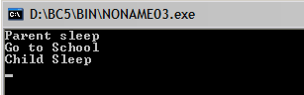
What is the output?
class Parent
{
public:
void sleep() {cout<<"Parent sleep \n";}
};
class Child: public Parent
{ public:
void gotoSchool() {cout<<"Go to School \n";}
void sleep() {cout<<"Child Sleep \n";}
};
int main( )
{
Parent parent;
Child child;
Parent *pParent = &child; // upcast - implicit type cast allowed
Child *pChild = (Child *) &parent; // downcast - explicit type case reqd
pParent -> sleep();
pParent -> gotoSchool(); // error :gotoSchool is not member of Parent
pChild -> gotoSchool();
pChild -> sleep();
}

